Slide 1
“How-To” of CE’s

Slide 2
Filing a New Course
Submit the following items to the NABIP Ohio office via fax (216) 803-9900 or email Mary@nabipohio.org
Course Offering Schedule
Course title, location, schedule, contact person & phone number
Form available at ohioahu.org/how-to-new-course
Course Outline
Include time for each topic listed
If there is a change in class date, location or instructor you must notify the NABIP Ohio Chapter office immediately.
Course content MAY NOT be changed from the original submission for CE credit.
All requests for course approval must be submitted at least 30 calendar days in advance of the requested approval date.

Slide 3
Scheduling an Approved Course
Course outlines are available at
nabipohio.org/ce-courses-speakers or can be requested from the NABIP Ohio Chapter office. Courses may not be substantially altered (changes that would alter the content or time allocations or topics)
Submit the following items to the NABIP Ohio Chapter office via fax (216) 803-9900 or email Mary@nabipohio.org
Course Offering Schedule
Course title, location, schedule, contact person & phone number
Form available at ohioahu.org/how-to-new-course
Existing Course offerings must be received at least 10 days in advance of the date the course will be held to file a new class.
If there is a change in class date, location or instructor you must notify the NABIP Ohio Chapter office immediately.
Course content MAY NOT be changed from the original submission for CE credit.

Slide 4
CE Code of Conduct
Please turn off your cell phones
Please keep all unrelated reading material out of sight
Please refrain from unrelated side conversations
Please sign in and out of each session for credit using your correct NPN number
Webinars: You MUST pay attention to the entire presentation and INTERACT when requested. Failure to do so will result in not receiving your credit.
NABIP, NABIP Ohio and Prometric are not responsible for anyone not receiving their CE credit. That is the decision of the applicable state department based on audit reviews and recommendations. Attendee conduct is taken into account as the instructor should eliminate any distractions.

Slide 5
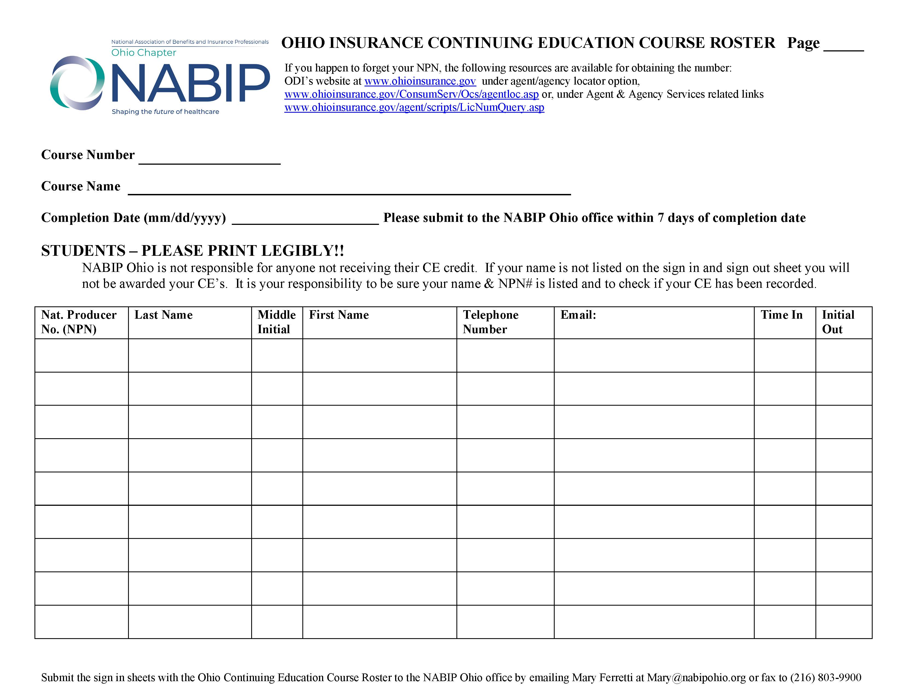
Print your name legibly
Enter your correct National Producer No. (NPN)
Sign In / Out Sheet
Sign out after the session for credit

Slide 6
After the Course
Submit the sign in/out sheets AND a typed Attendance Roster to the NABIP Ohio Chapter office within one week following the class date. Documents should be emailed to mary@nabipohio.org.
Sign in/out sheet can be found at nabipohio.org/how-to-new-course
NOTE: ODI and/or Thomson Prometric periodically will audit continuing education classes. Their representative will identify themselves and may attend any course for the purpose of an audit without paying a fee.

